Slide 1


Slide 2
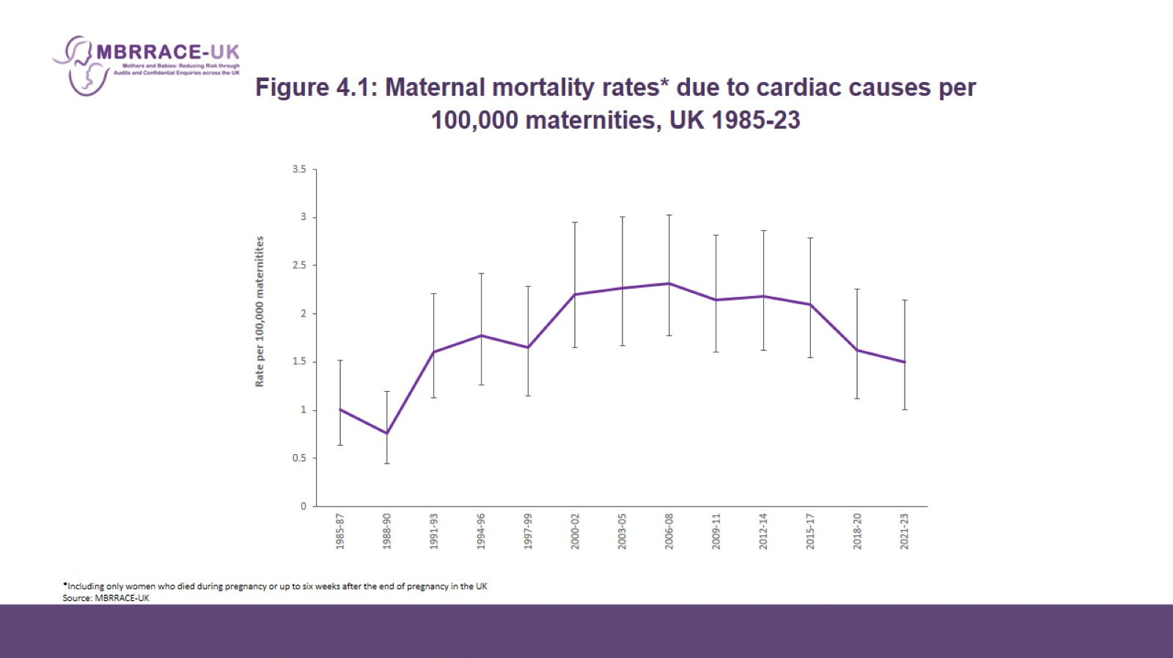
Figure 4.1: Maternal mortality rates* due to cardiac causes per 100,000 maternities, UK 1985-23

Slide 3
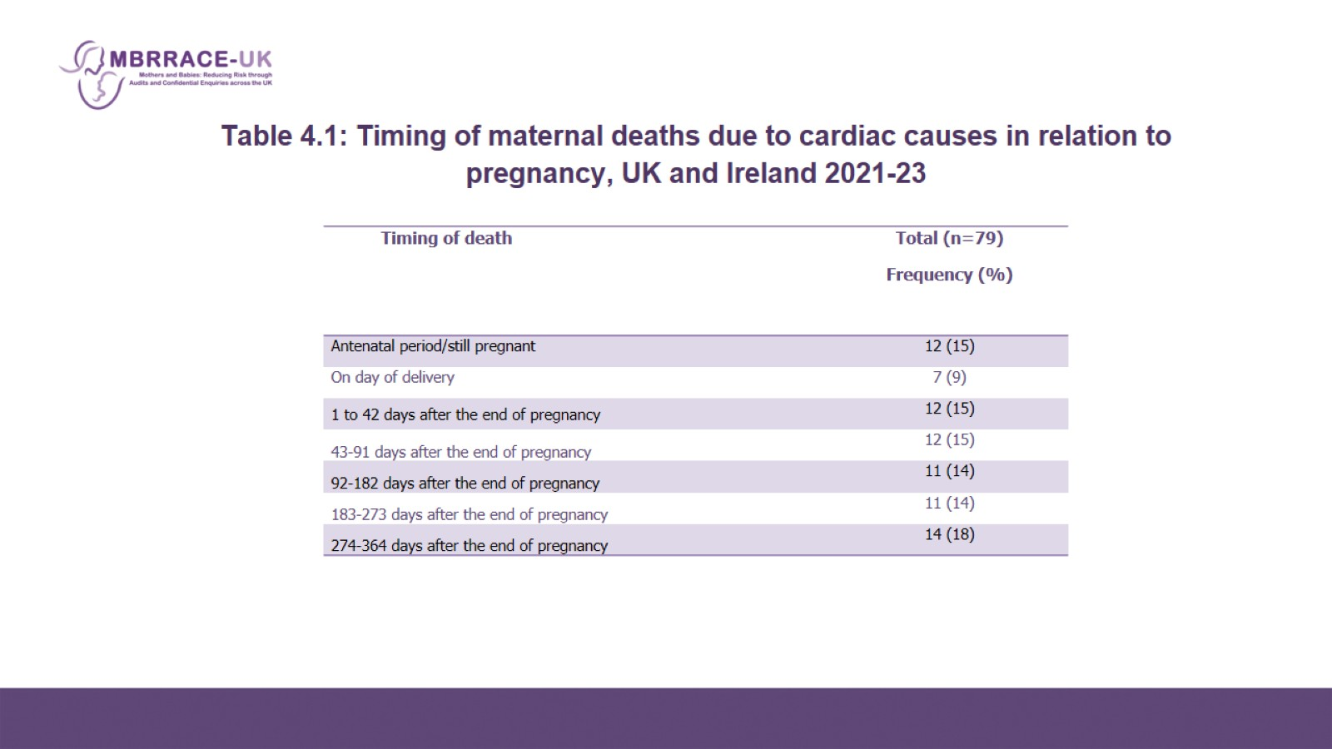
Table 4.1: Timing of maternal deaths due to cardiac causes in relation to pregnancy, UK and Ireland 2021-23

Slide 4
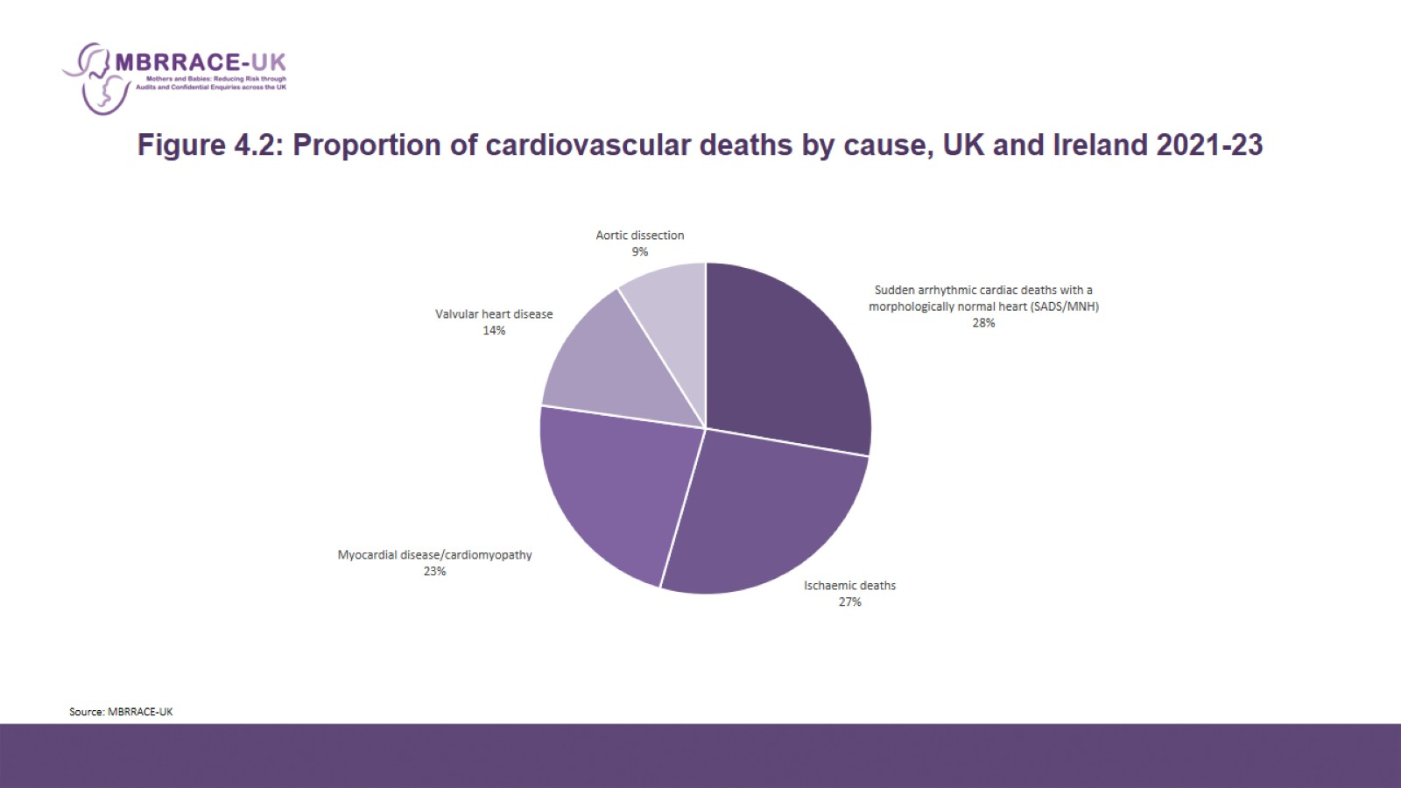
Figure 4.2: Proportion of cardiovascular deaths by cause, UK and Ireland 2021-23

Slide 5
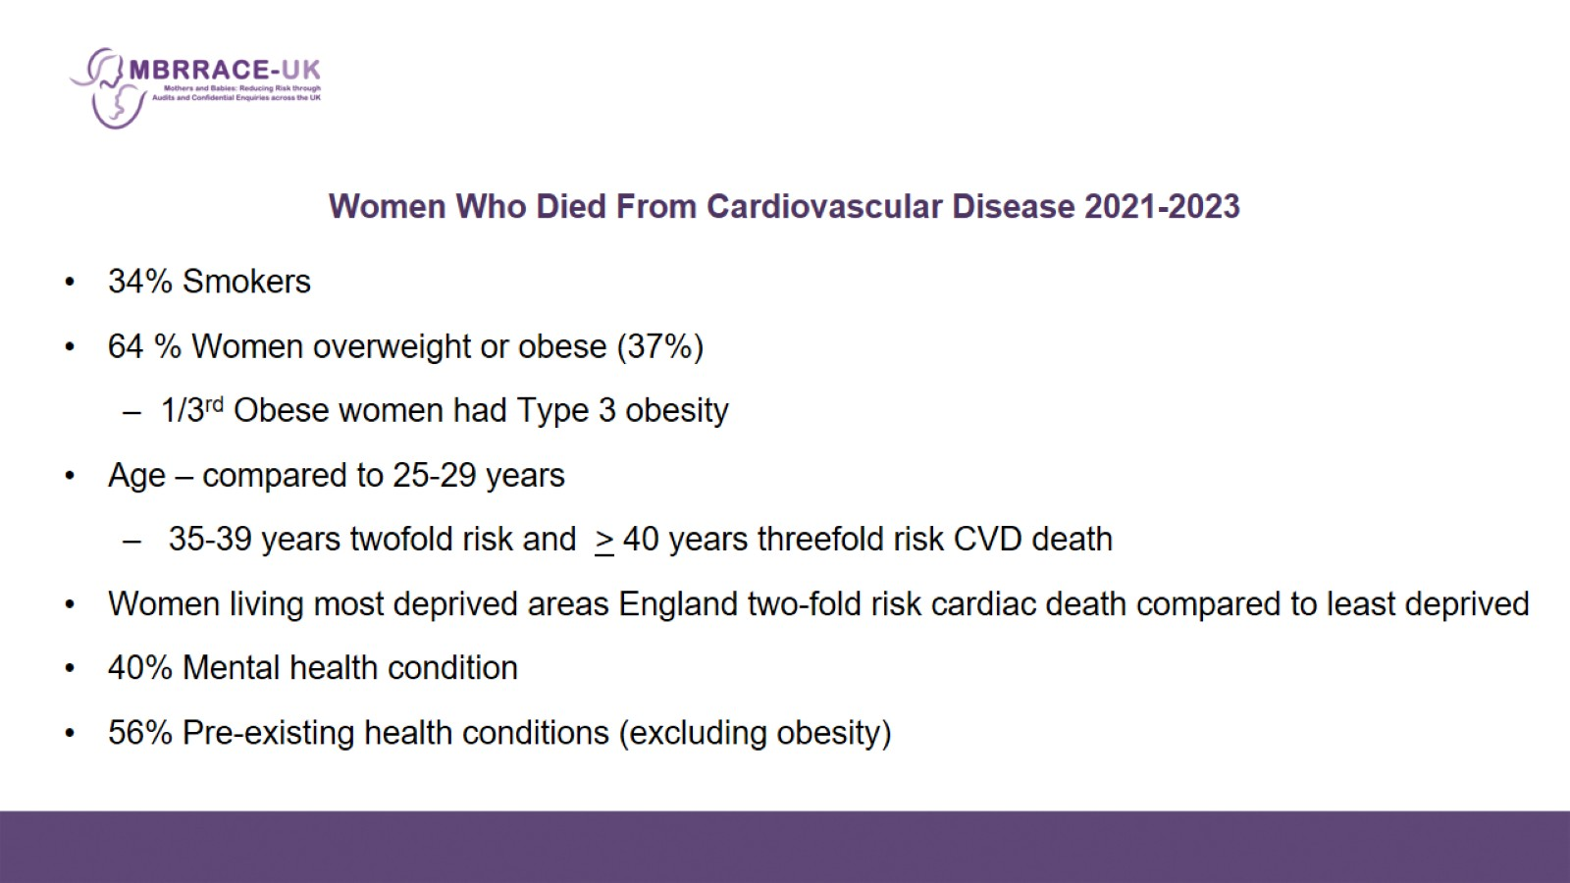
Women Who Died From Cardiovascular Disease 2021-2023

Slide 6
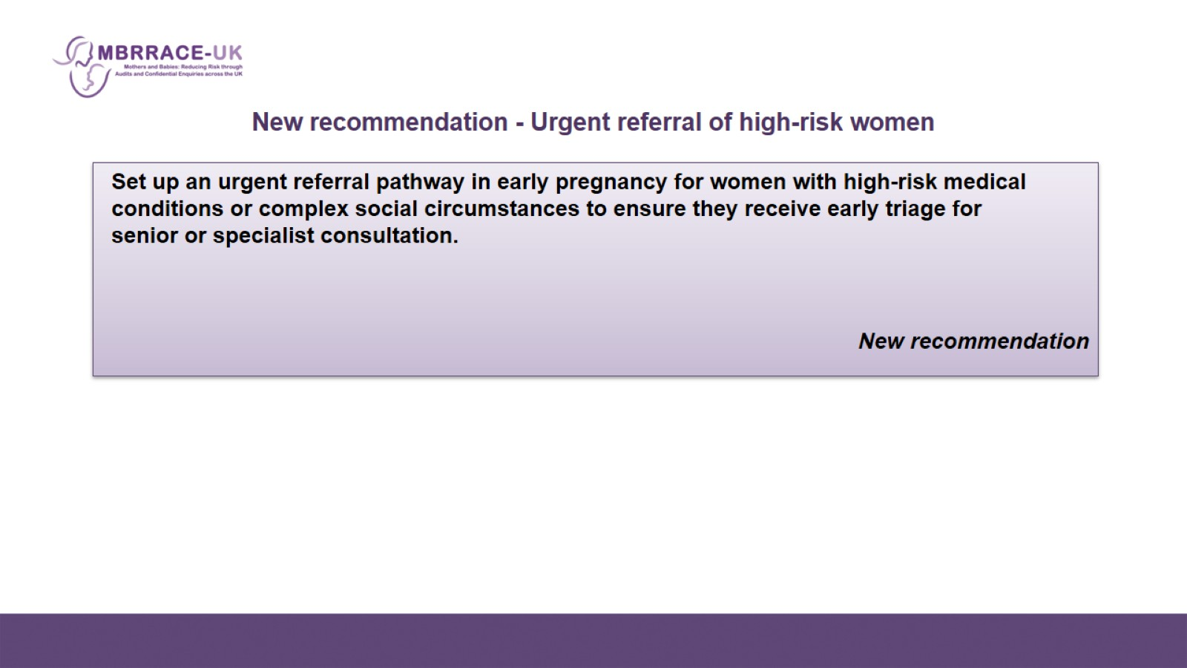
New recommendation - Urgent referral of high-risk women

Slide 7
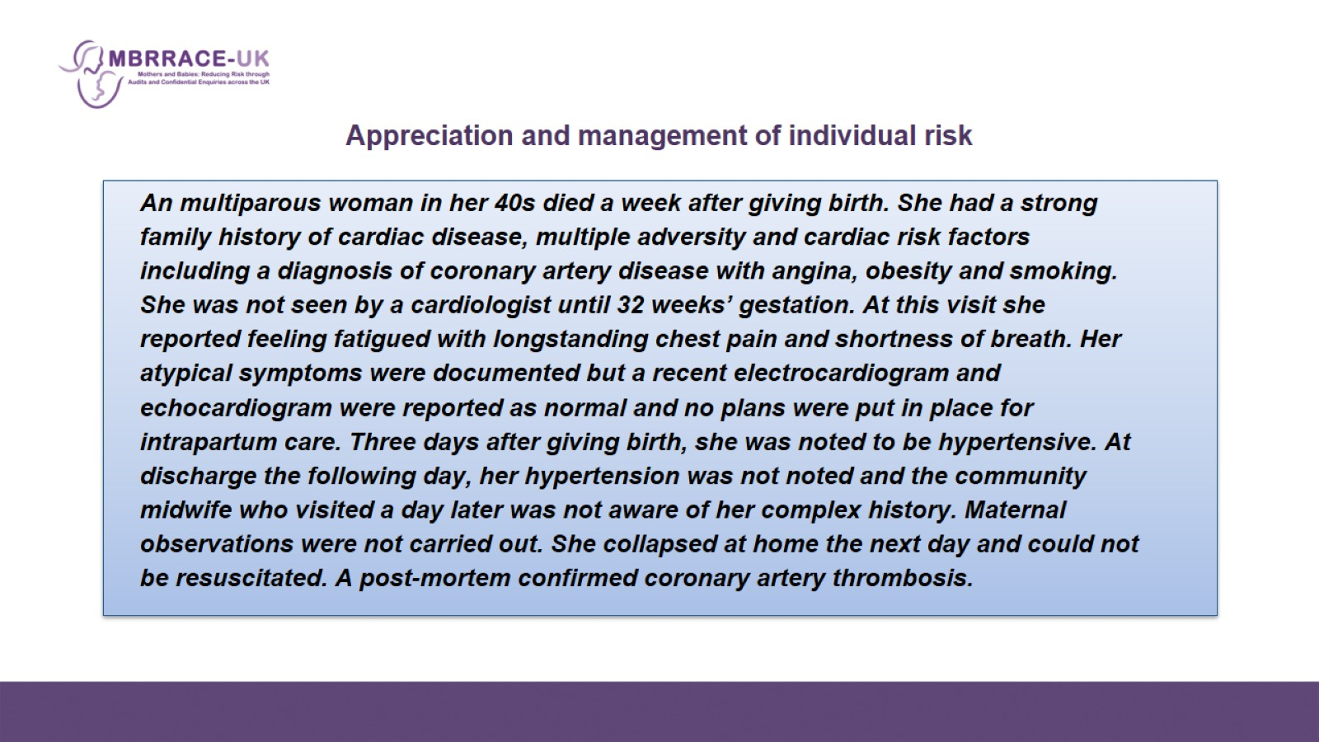

Slide 8
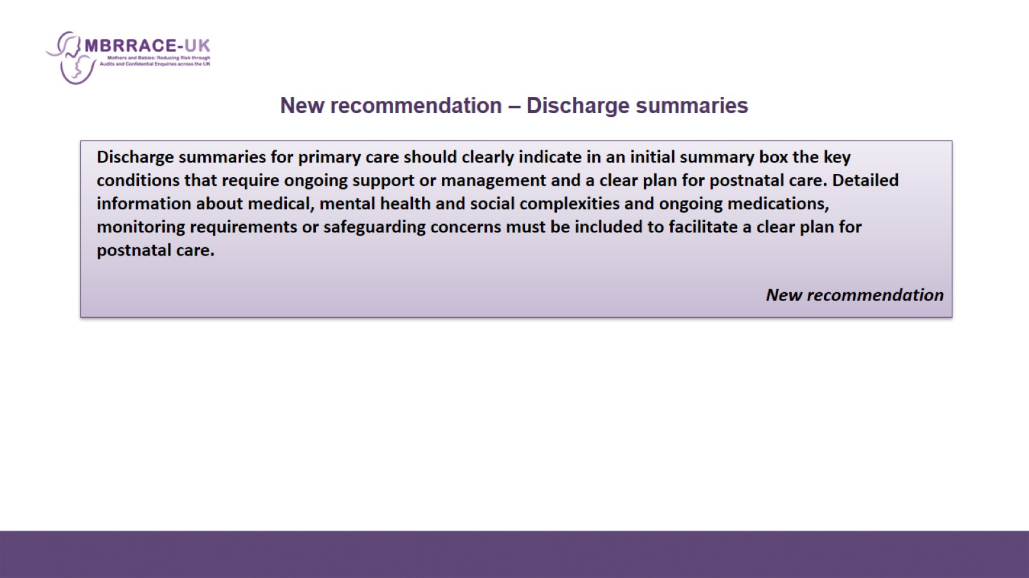
New recommendation – Discharge summaries

Slide 9
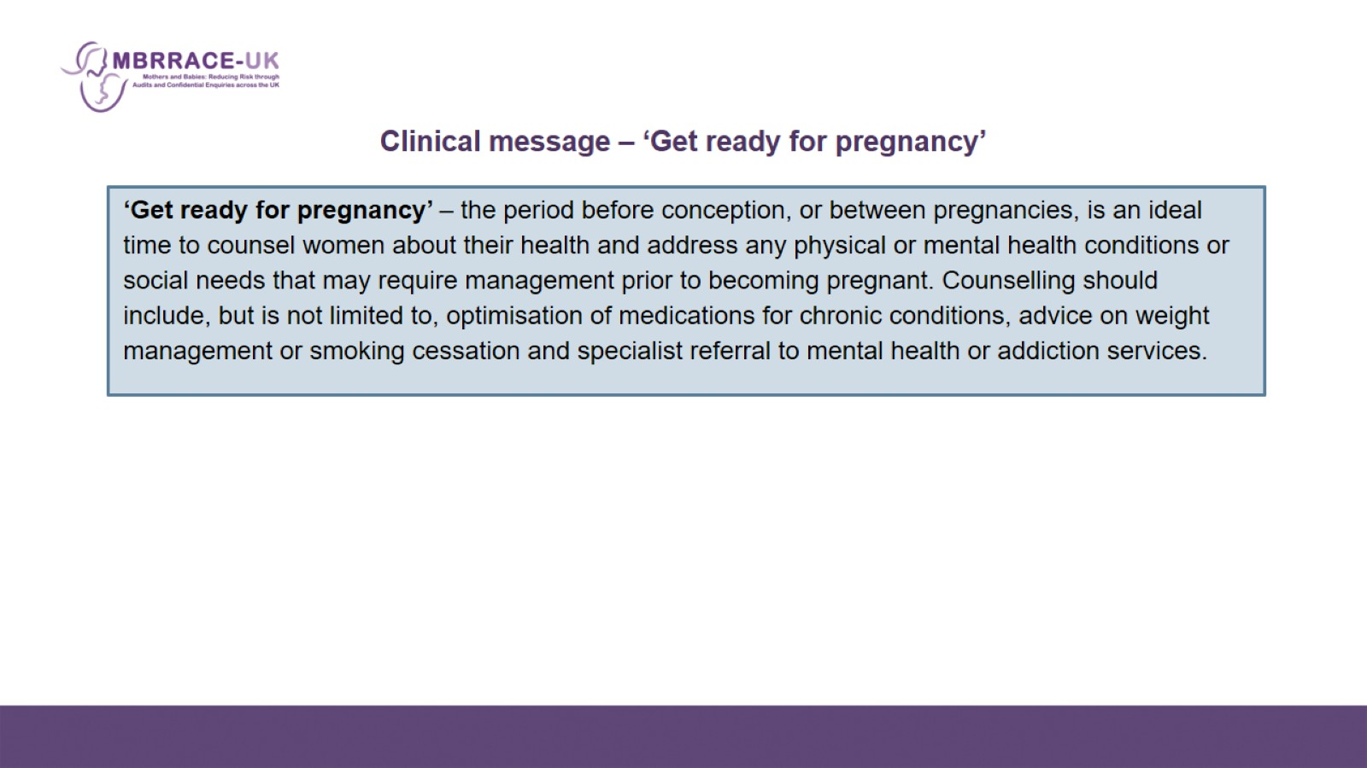
    Clinical message – ‘Get ready for pregnancy’

Slide 10
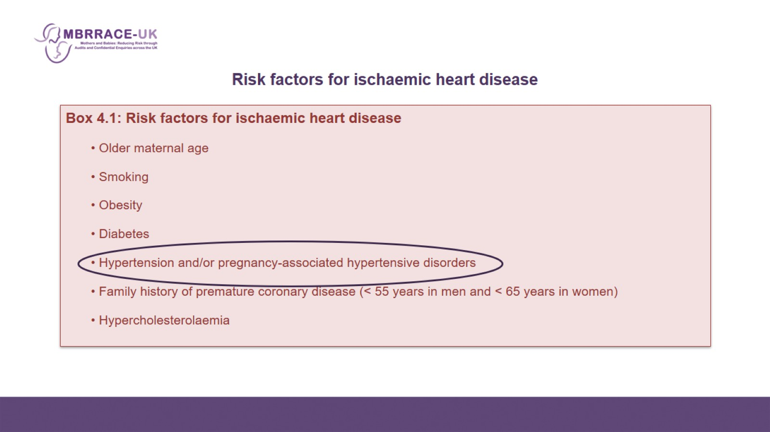
    Risk factors for ischaemic heart disease

Slide 11
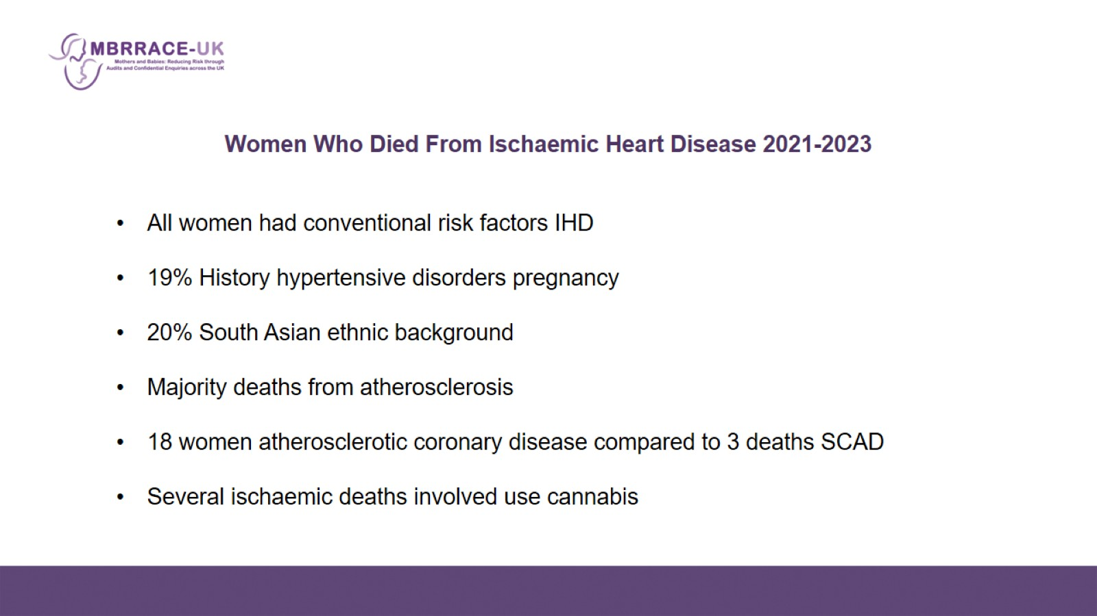
Women Who Died From Ischaemic Heart Disease 2021-2023

Slide 12
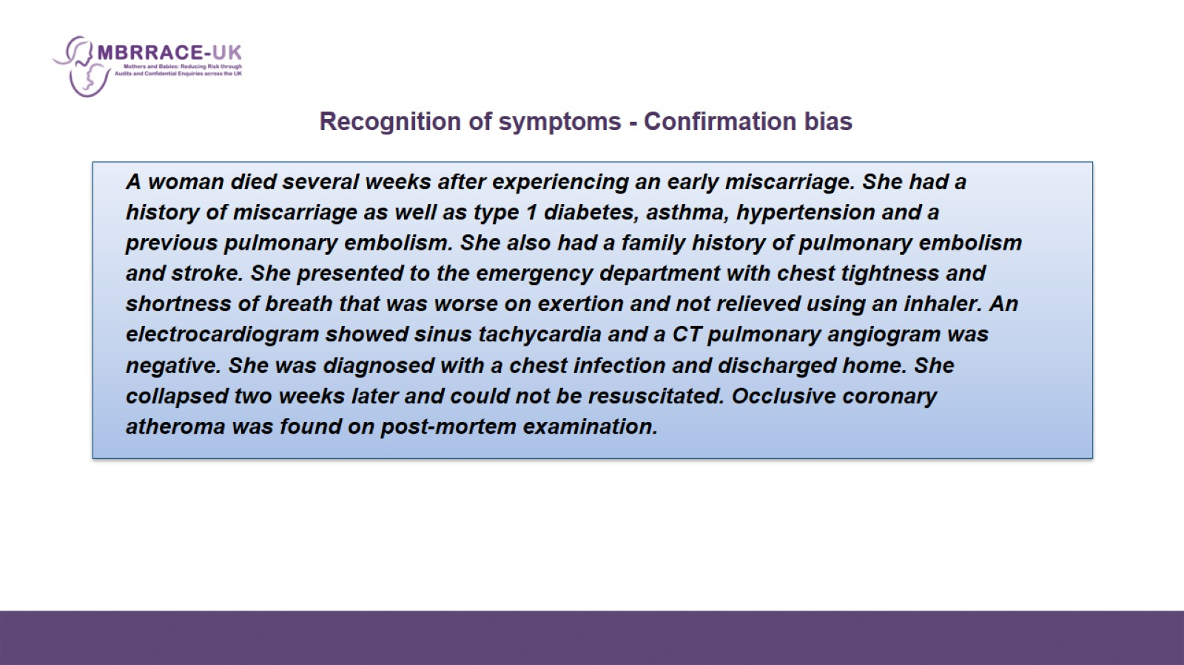

Slide 13
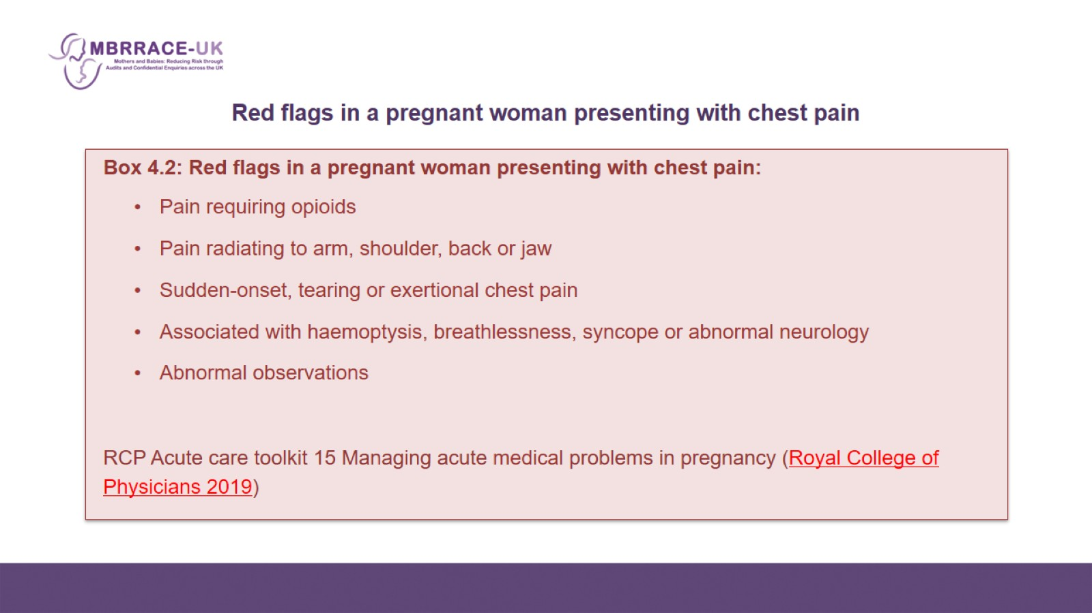
    Red flags in a pregnant woman presenting with chest pain

Slide 14
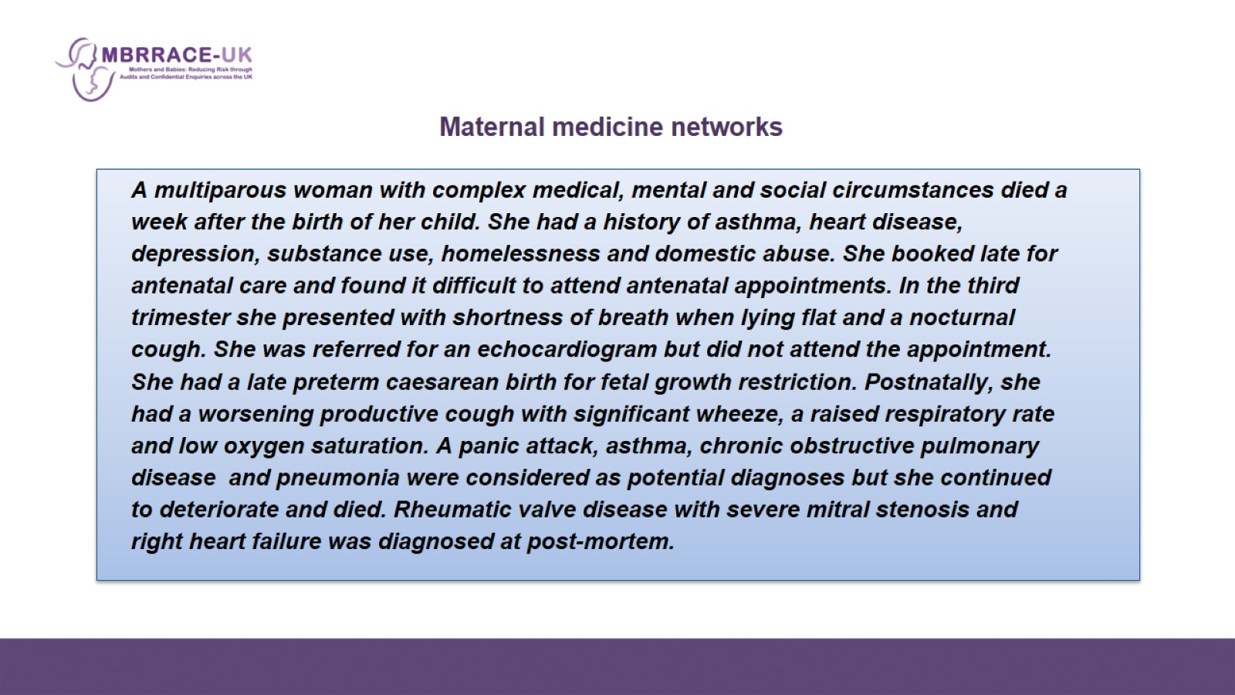

Slide 15
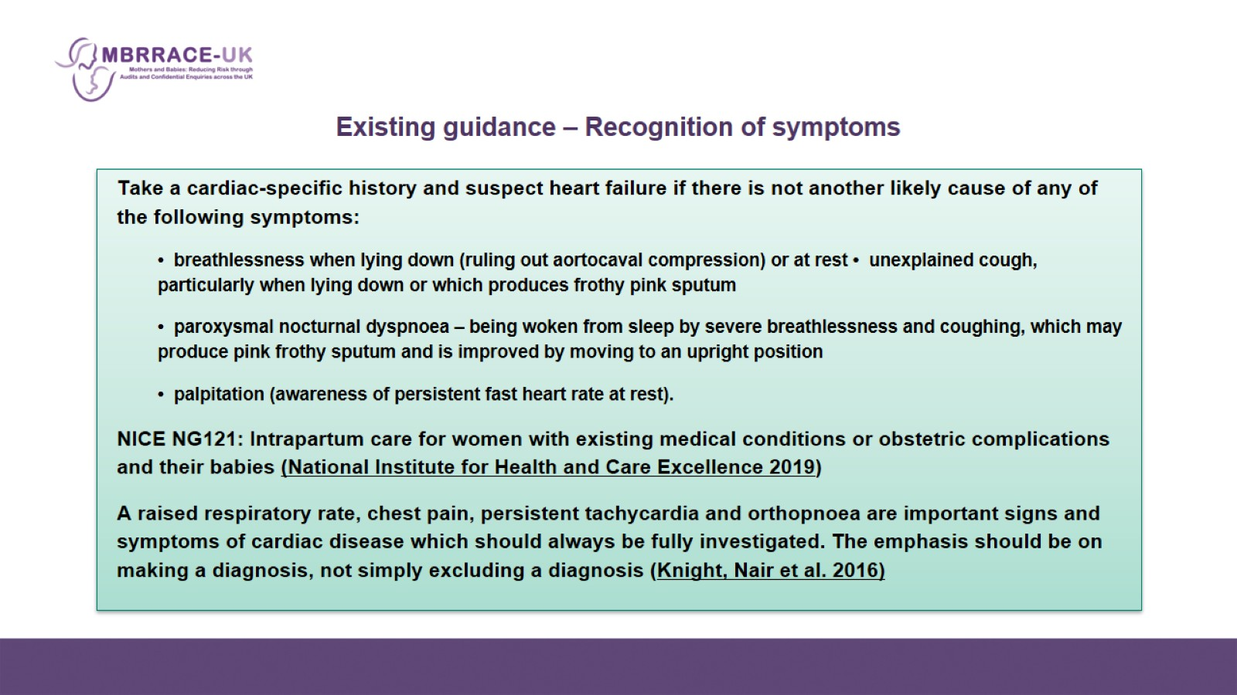
Existing guidance – Recognition of symptoms

Slide 16
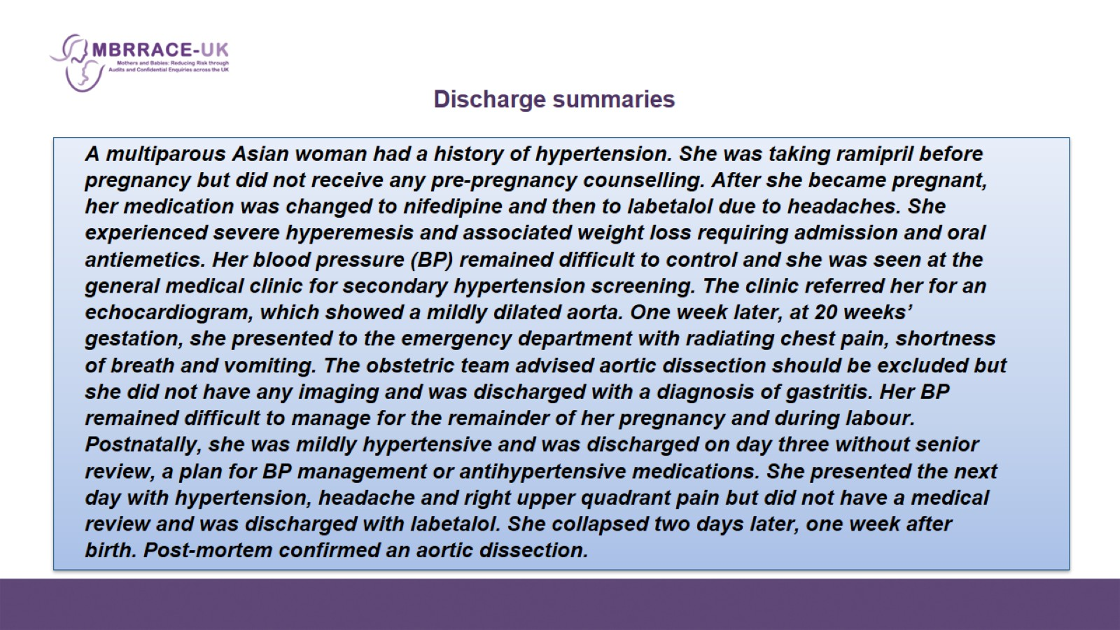

Slide 17
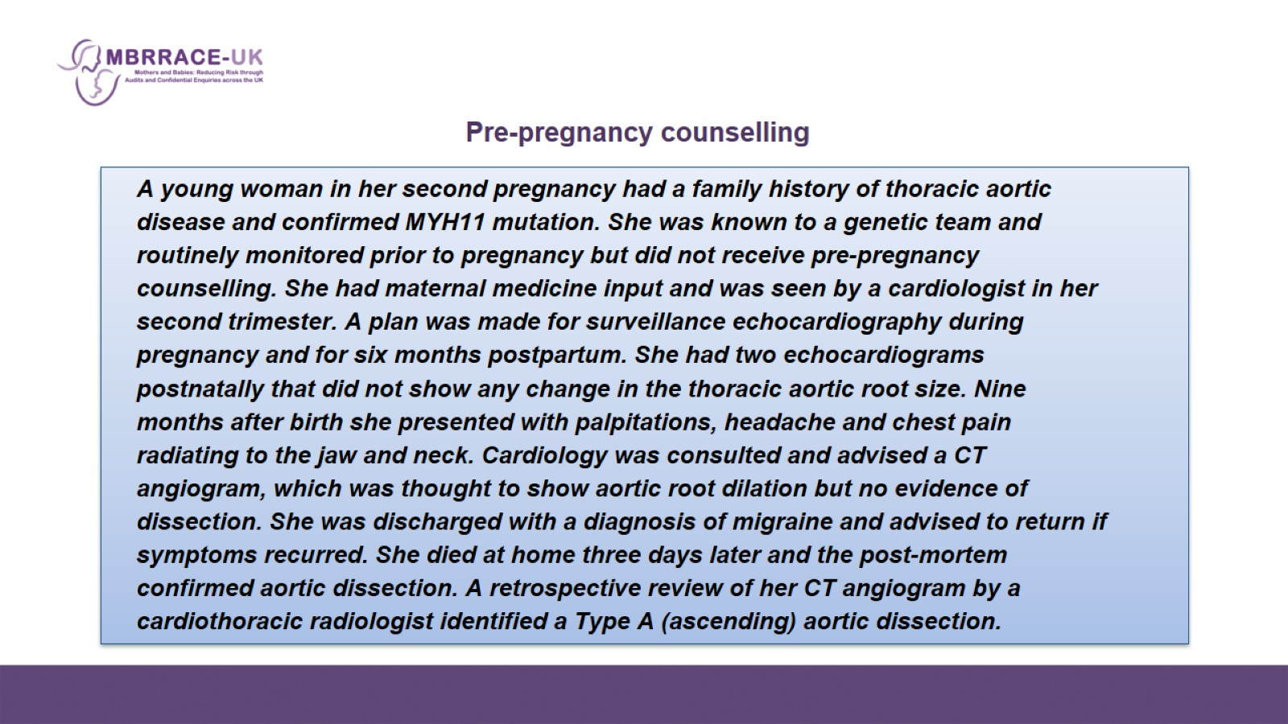

Slide 18
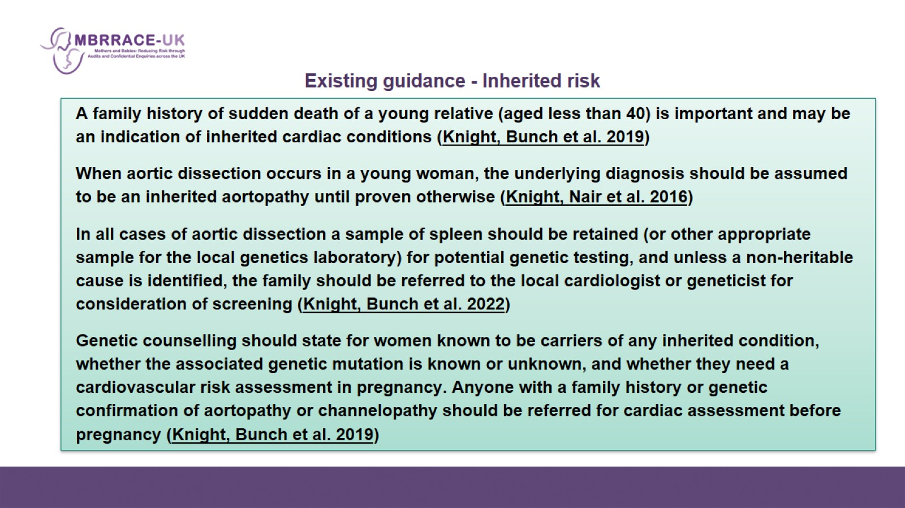
Existing guidance - Inherited risk

Slide 19
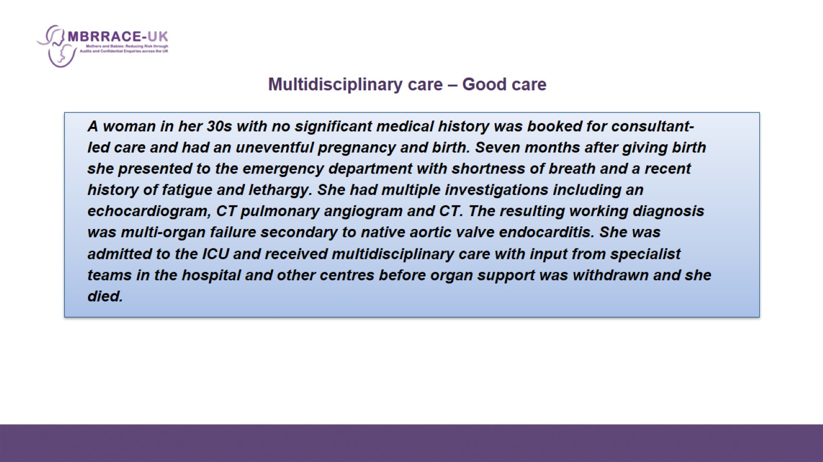

Slide 20
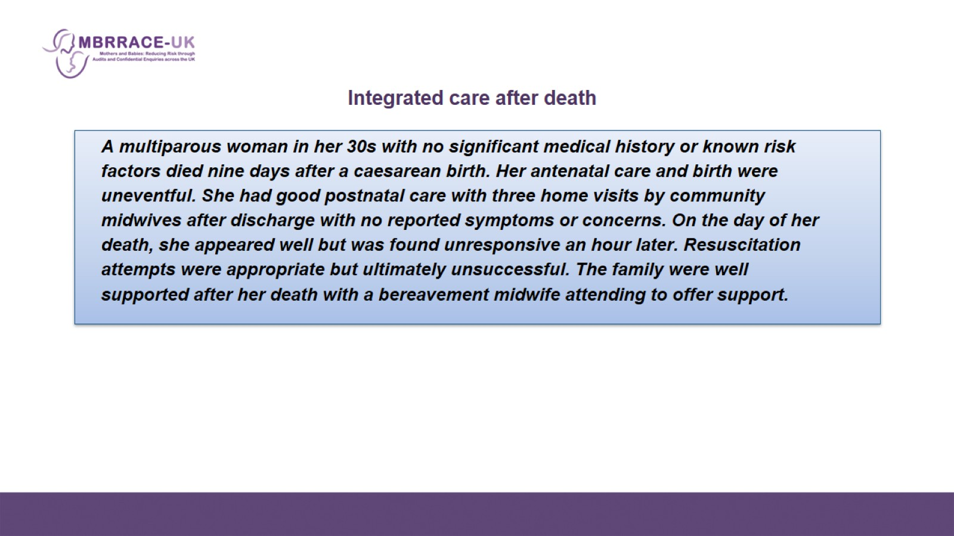

Slide 21
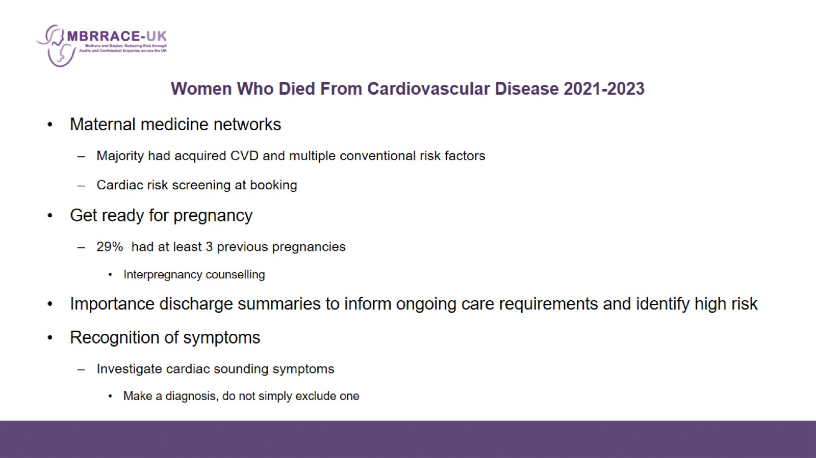
Women Who Died From Cardiovascular Disease 2021-2023

